Slide 1


38_Presentation
Convert Sign Language To Text
Assiut University
1/26

Slide 2
Table of Contents:
Team Member
Task description
Demo of the running application
Contribution
Data
Project architecture
Methods
Results
Assiut University
2/26

Slide 3
Team Member.
Assiut University
3/26

Slide 4
Team Member
38_Team
Khaled Ibrahem Al-Desouky ID 162021111
Khaled Ahmed Mohamed ID 162021113
Hassan Khaled Mohamed ID 162021104
4/26

Slide 5
2. Task description
Assiut University
5/26

Slide 6
Task description
The task involves creating a comprehensive guide or instructional material for learning American Sign Language (ASL).
ASL is a complete, natural language that has its own grammar and syntax and is used by deaf and hard of hearing individuals primarily in the United States and parts of Canada.
The goal of this task is to provide an accessible and effective resource for individuals interested in learning ASL, whether they are beginners or seeking to improve their proficiency.
Key Components:
Data Collection
Feature Extraction
Model Training
Real-time Gesture Recognition
Assiut University
6/26

Slide 7
3. Demo of the running application
Assiut University
7/26

Slide 8
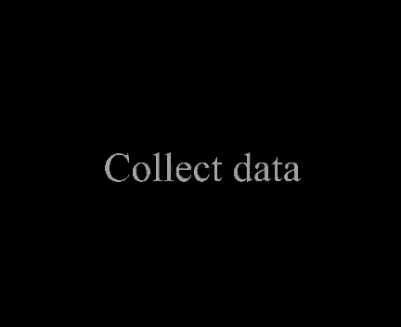
Demo
Assiut University
8/26

Slide 9
4. Contribution
Assiut University
9/26

Slide 10
Contribution
We enriched the code to support American Sign Language (ASL) translation:
This advancement enables the software to recognize and interpret hand gestures, effectively bridging communication gaps for individuals who rely on American Sign Language as their primary means of expression.
We improved the code by incorporating a voice output
function, allowing the program to audibly announce
recognized characters:
This enhancement provides real-time auditory feedback along with video processing, enhancing the overall user experience..
Assiut University
10/26

Slide 11
3. We have expanded the code's capabilities to not only recognize
individual characters but also to understand predefined
phrases such as "I love you", "Like" and "Dislike“.
This improvement expands the software's training range, allowing it to better accommodate diverse user interactions.
4. We have introduced a flexible training path, enabling users to
customize and expand the dataset with new gestures and
phrases.
The dataset creation process is highly adaptable, allowing users to easily capture and incorporate various hand gestures into the training data.
Assiut University
11/26

Slide 12
5. The dataset creation process is highly adaptable, allowing
users to easily capture and incorporate various hand gestures
into the training data.
This versatility, along with the inclusion of a bounding box outlining the detected hand, enables the software to learn from a wide range of gestures while providing visual feedback to users.
This improvement enhances the software's ability to accurately interpret user input and facilitate effective communication.
Assiut University
12/26

Slide 13
5. Data
Assiut University
13/26

Slide 14
Data
All data is available here: https://drive.google.com/drive/folders/1pWfn826toqbvN4z61YLNzhapyvHHAZX8?usp=drive_link
Some data when training:
Figure 1. Alphabet “B”.
Figure 2. Alphabet “I LOVE YOU”.
Assiut University
14/26

Slide 15
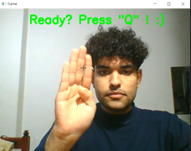
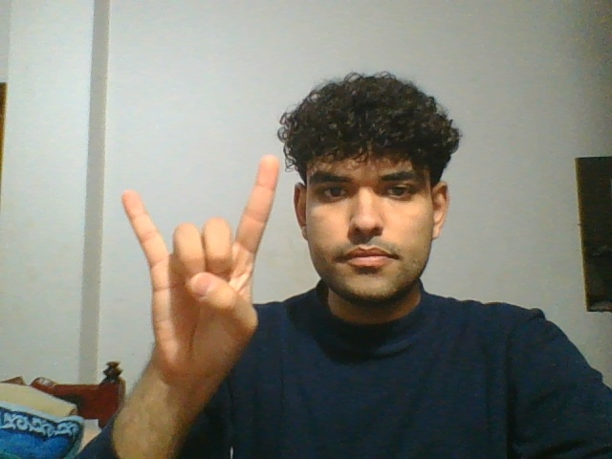
Figure 1. Alphabet “B”.
Figure 2. Alphabet “I LOVE YOU”.
Assiut University
15/26

Slide 16
6. Project architecture
Assiut University
16/26

Slide 17
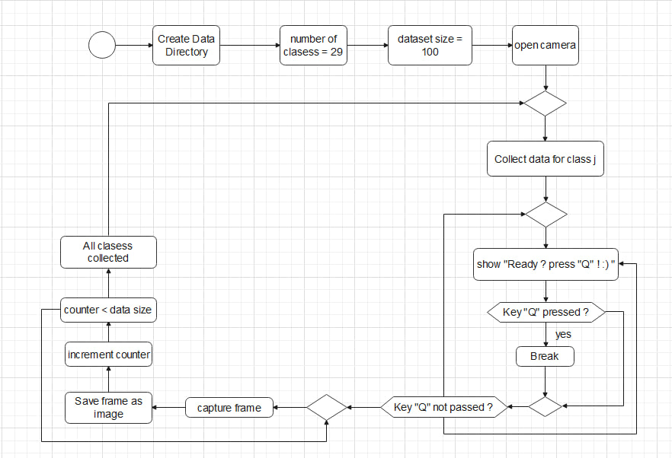
Project architecture
1. Collect Data in figure 3.
Figure 3. Flowchart to explain how model collect data
Assiut University
17/26

Slide 18
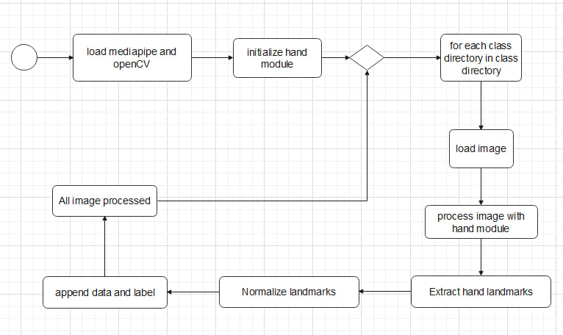
2. Hand initialization in Figure 4.
Figure 4. Flowchart to explain how model make Hand initialization
Assiut University
18/26

Slide 19
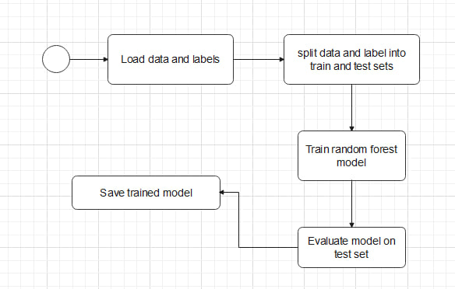
3. Training Model in Figure 5.
Figure 5. Flowchart to explain how model training model
Assiut University
19/26

Slide 20
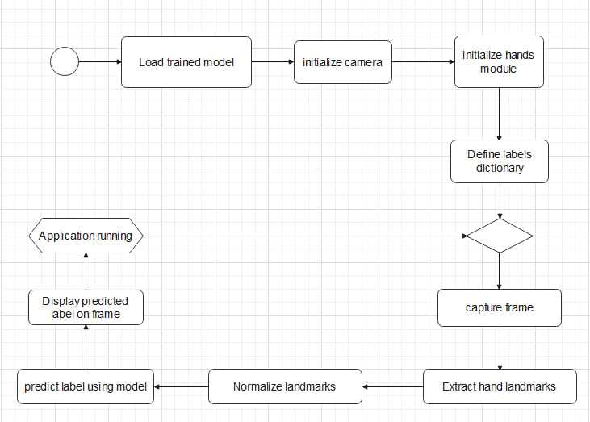
4. Real-time Gesture Recognition in Figure 6.
Figure 6. Flowchart to explain how model Real-time Gesture Recognition
Assiut University
20/26

Slide 21
7. Methods
Assiut University
21/26

Slide 22
Methods
Support Vector Classifier (SVC) :
This model is trained using the SVC() class from scikit-learn (sklearn.svm).
It's a supervised learning model used for classification tasks.
In the provided code, it's trained to classify hand gestures based on extracted hand landmarks.
Assiut University
22/26

Slide 23
Methods
2. MediaPipe Hands Model :
This model is utilized through the mp_hands.Hands() method from the MediaPipe library (mediapipe.solutions.hands).
It's a pre-trained model designed for detecting hand landmarks in images.
The detected landmarks are used as features for training the SVC model and for real-time hand gesture recognition.
Assiut University
23/26

Slide 24
8. Results
Assiut University
24/26

Slide 25
Results
Accuracy of the model which is made is 100%
Assiut University
25/26

Slide 26
Thank You

